Slide 1
Cardiovascular Disease Prediction
BE 188: Machine Learning and Data-Driven Modeling in Bioengineering
Nilay Shah, Aditya Gorla

Slide 2
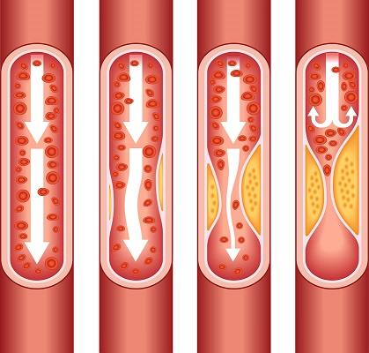
Introduction
Cardiovascular disease(CVD) is number one cause of death worldwide and leads to more than 600,000 deaths in the United States annually
CVD healthcare is still very reactive
We would like it to be proactive

Slide 3
Data
CVD dataset was obtained from a challenge hosted by DrivenData
It was compiled from the Cleveland Heart Disease Database
Consists of a subset of 14 attributes from 180 patients
Has ordinal, numerical and categorical data

Slide 4
Key Model Evaluation Metrics
Precision: ∑ True Positive/ ∑ Predicted Positive (i.e. the ability of the classifier to not label a sample as positive if it is negative)
Recall: True Positive rate or Sensitivity. ∑ True Positive/ ∑ All Positive (i.e the ability of the classifier to find all the positive samples)
Log Loss: measures the performance of a classification model’s predictive ability by penalizing the predicted probability as it diverges from the actual label
ROC AUC: quantifies the diagnostic ability of a binary classifier system as its discrimination threshold is varied

Slide 5
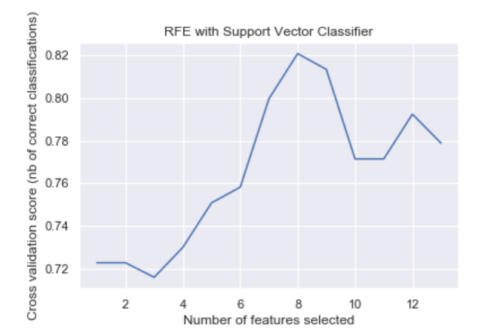
Feature Selection
Parameter Optimization
Model Building
K-fold Cross-Validation
Recursive feature elimination with cross-validation (RFECV)
Run with both logistic regression model and linear support vector classifier
Produced 6 common features and 3 variable features
Created a powerset of the 3 variable features and combined each with the 6 common ones
Determined optimal combination of features for each classifier
Used GridSearchCV to exhaustively search parameter values with cross-validation
Built logistic regression and SVM models with the best no. of features for each and their optimized parameters
Logistic Regression:
SVM Model:
Ran stratified 80-fold Cross-Validation
Stratification ensures each fold contained roughly the same proportions of the two types of class labels
{'logistic__C': 0.02, 'logistic__penalty': 'l2', 'logistic__solver': 'newton-cg'}
{'svc__C': 0.05, 'svc__degree': 3, 'svc__gamma': 'auto', 'svc__kernel': 'poly'}

Slide 6
Logistic Regressions Results
True Value
Predicted Value
Data obtained from 80-fold Stratified Cross Validation

Slide 7
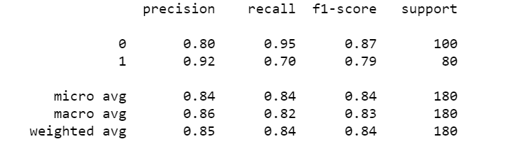
Log loss: 0.458

Slide 8
SVC Results
True Value
Predicted Value
Data obtained from 80-fold Stratified Cross Validation

Slide 9
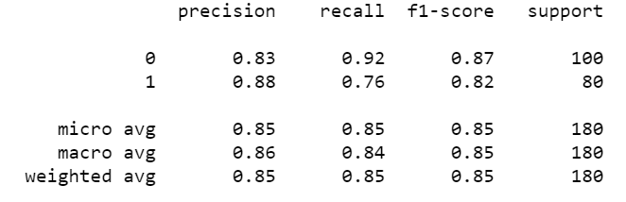

Slide 10
Conclusion/Future Directions
Log Loss of 0.42277 achieved with best model submitted to competition - top 21% of submissions
Continue to optimize model to achieve log loss ~0.25
Logistic Regression model minimizes false positives, while SVM model minimizes false negatives
Considering combining dataset with predictions from logistic regression and SVM models to train boosted decision trees to improve Sensitivity and Specificity

